Slide 1
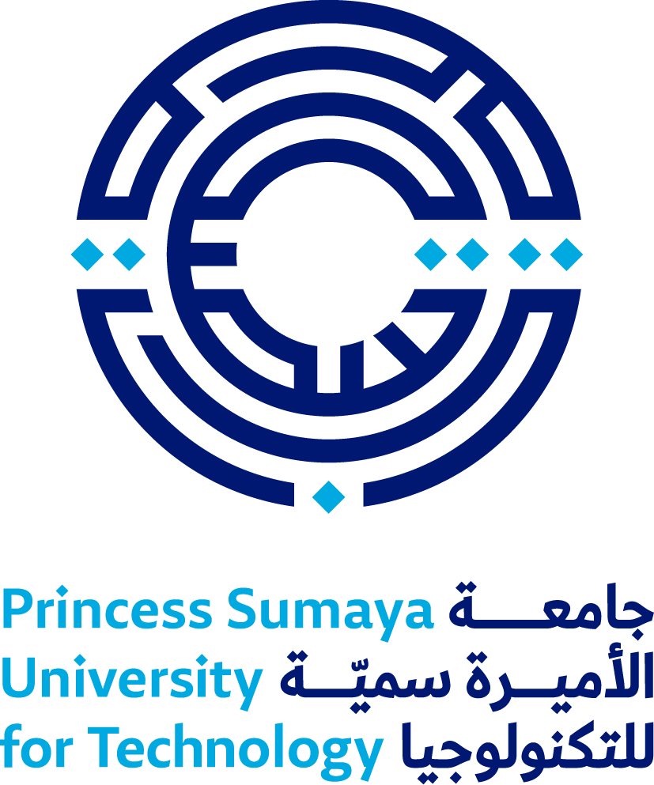
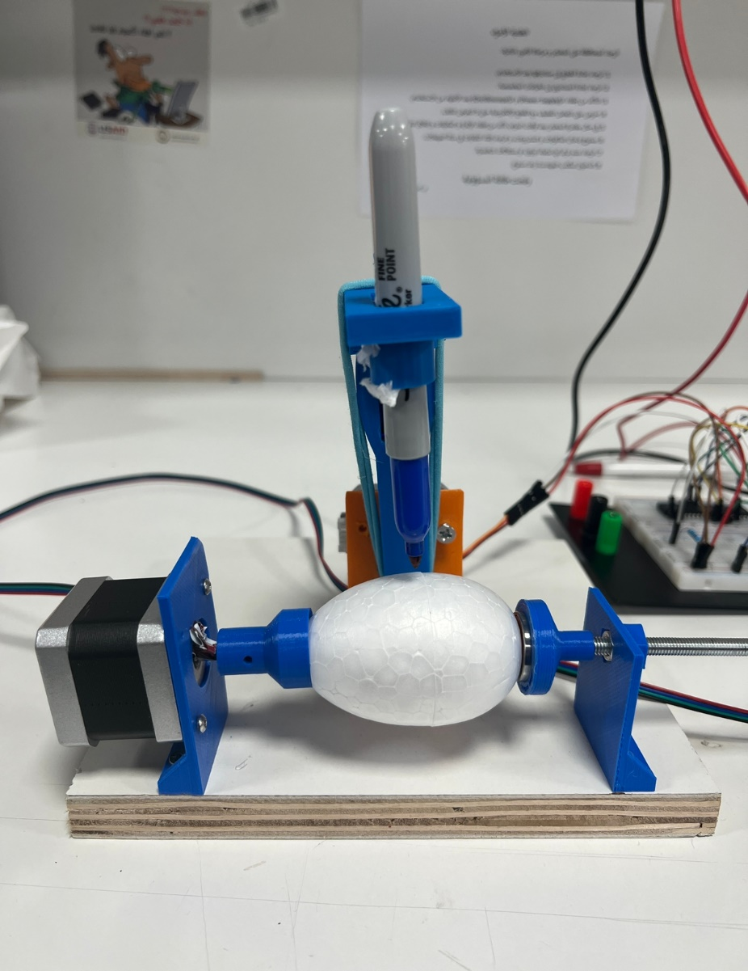
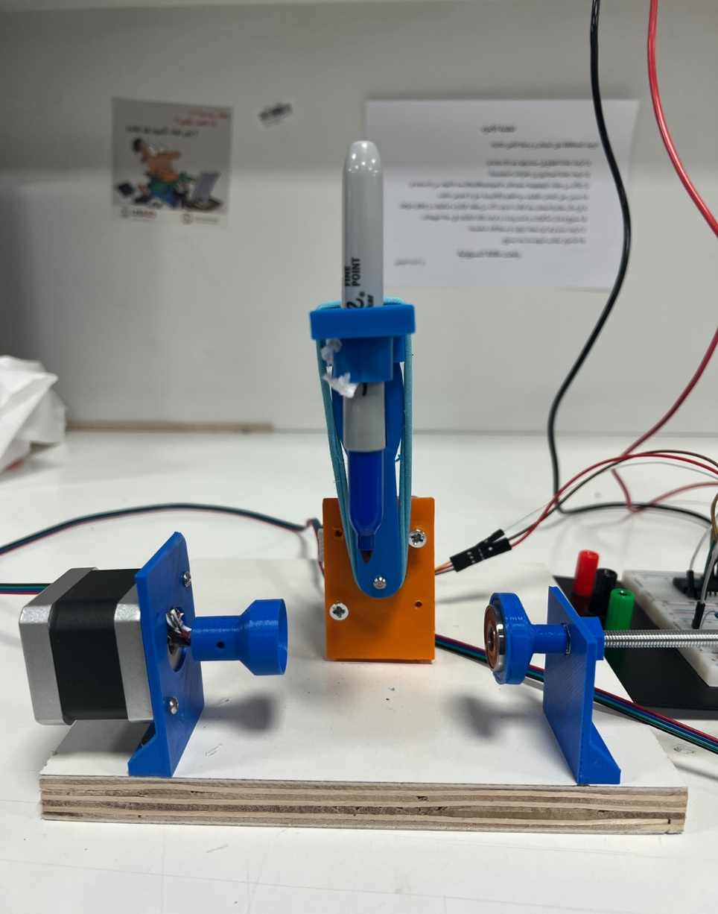
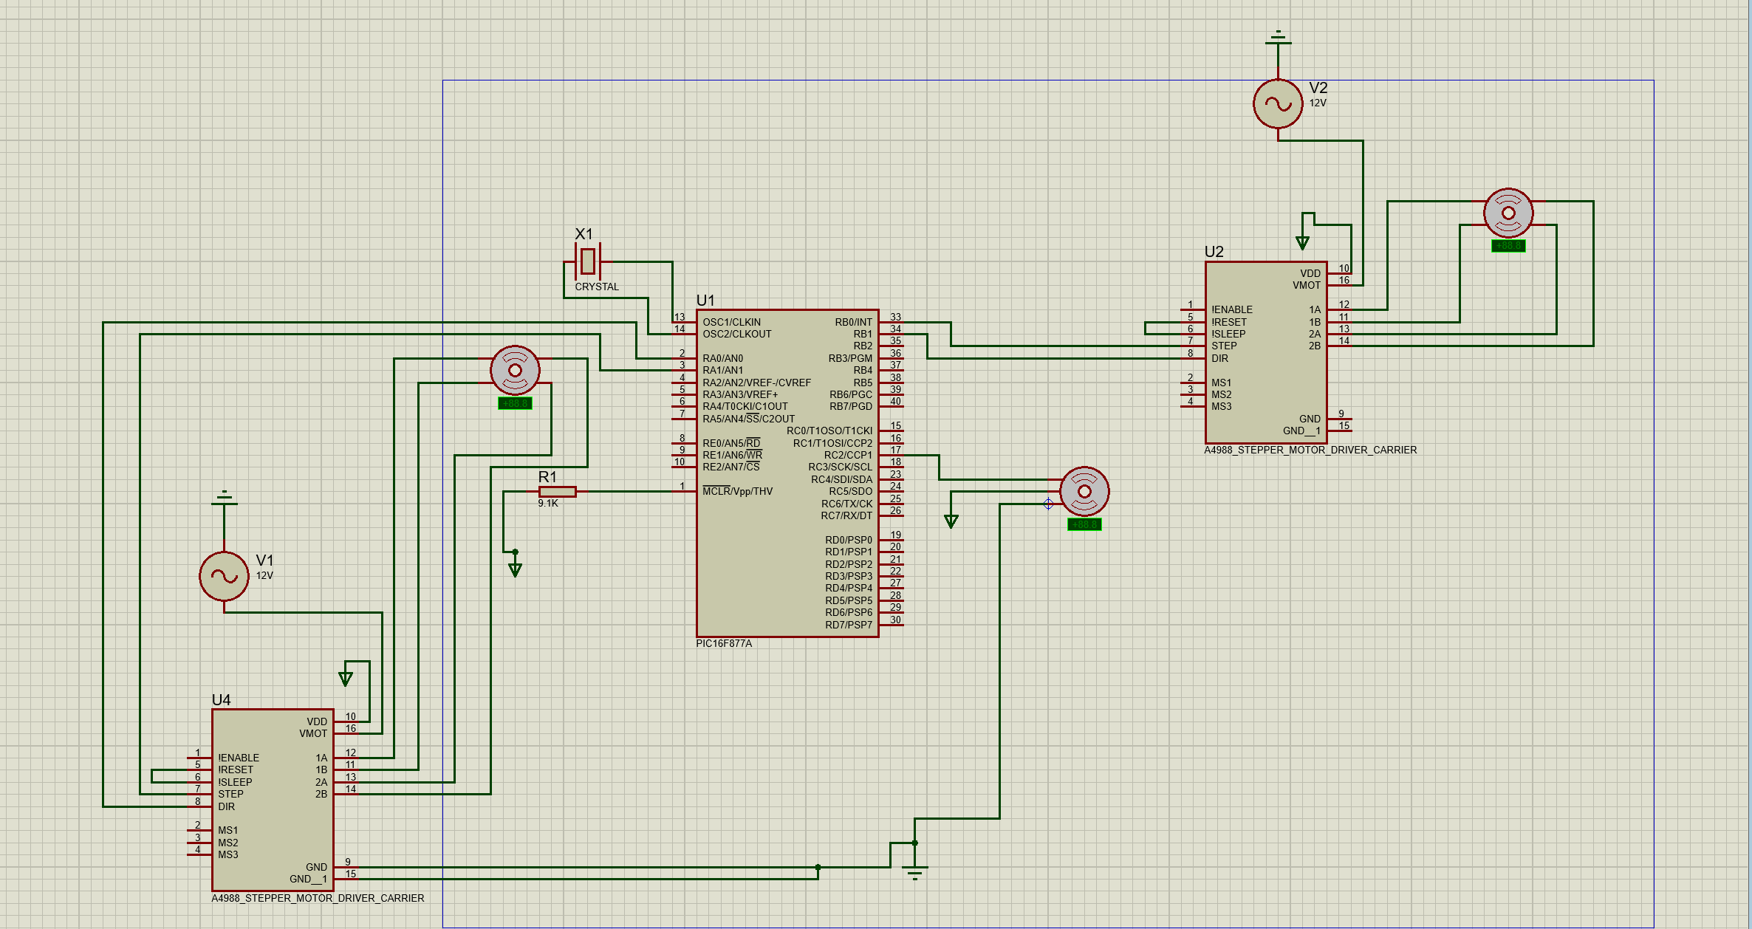
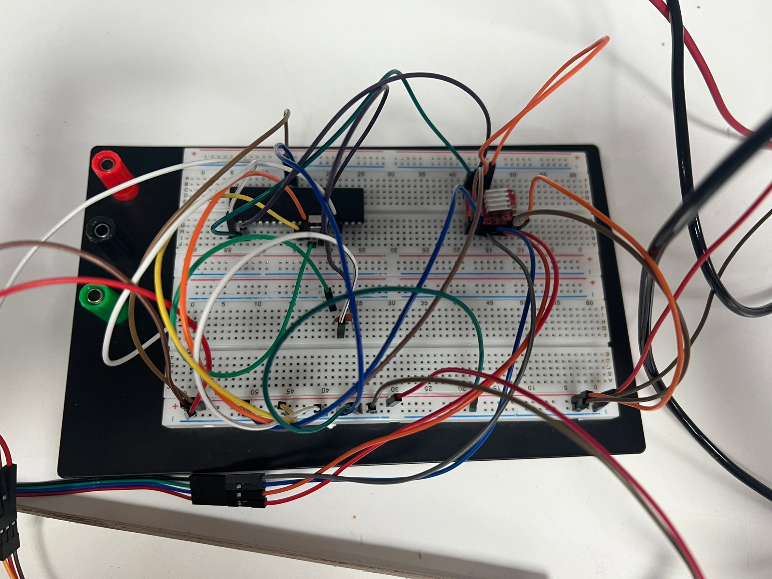
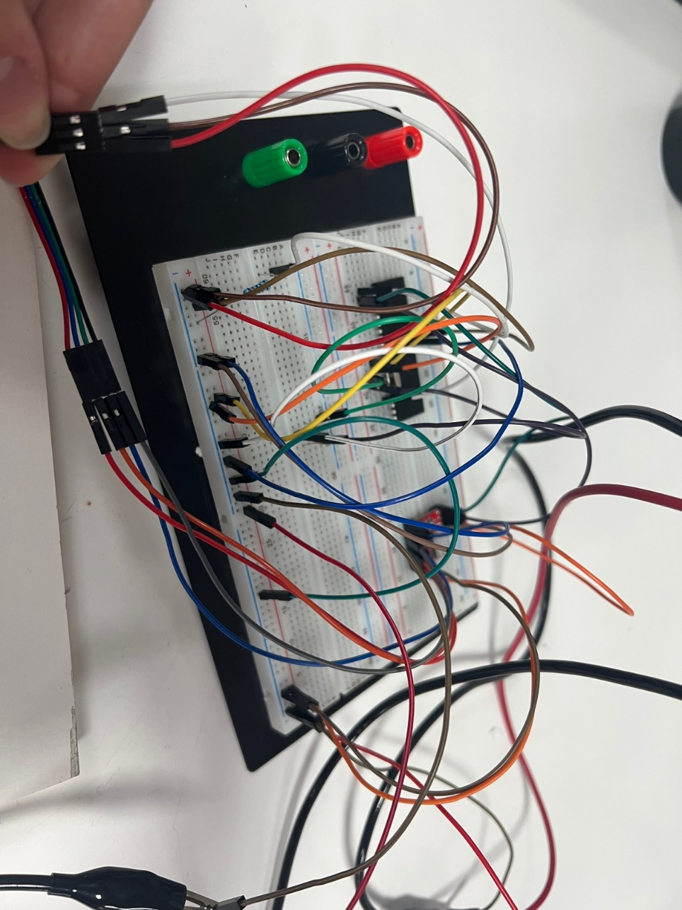
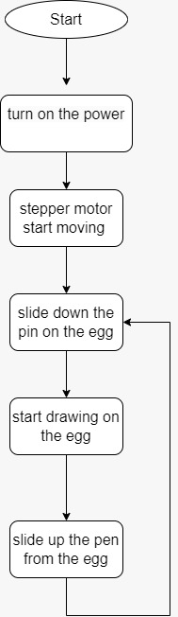
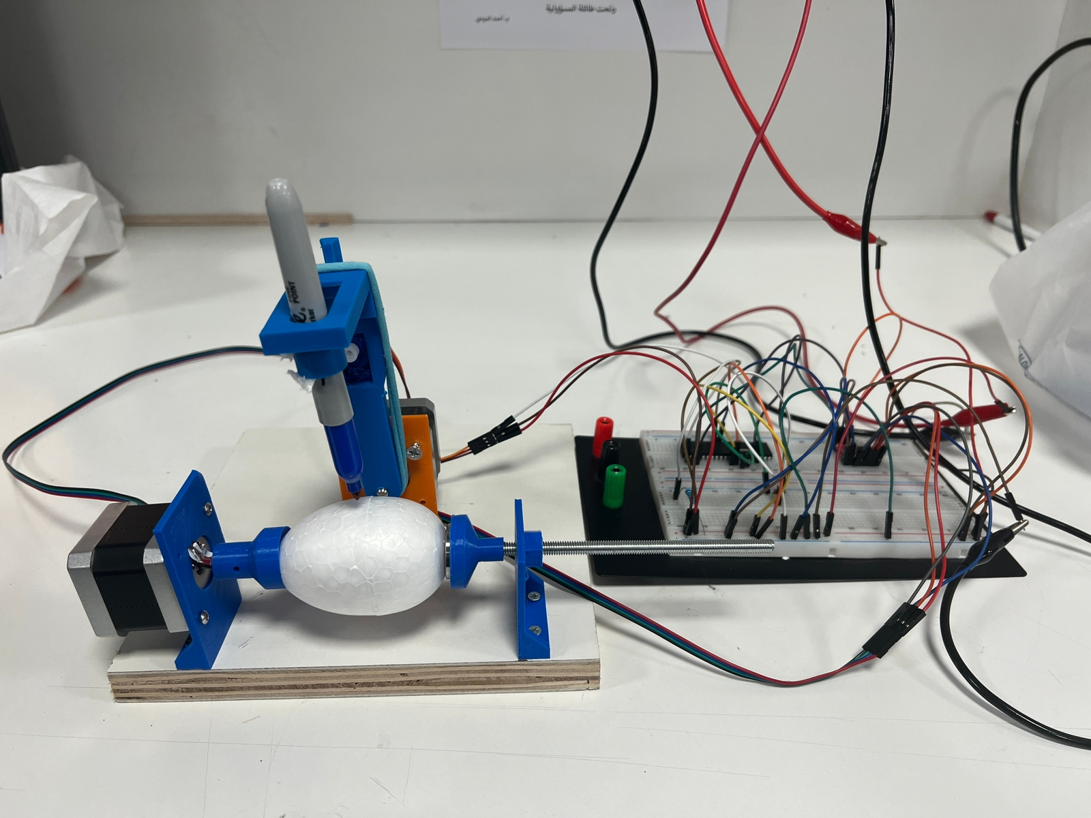
Egg Drawing machine
E.Odeh , J. Hamdan,and D. Abdelhafez
Supervisor: Dr. Belal Sababha
Embedded Systems Final Design Project, Fall 2022
King Abdullah II School of Engineering
Princess Sumaya University for Technology
Introduction
We will creating an art robot called the EggBot, which is capable of drawing on small spheres and eggs. The EggBot was first invented by motion control artist Bruce Shapiro in 1990. Since then, it has been used in workshops as both an educational tool and a creative medium. In 2010, Bruce and our team began working together on designing and manufacturing EggBot kits.
In our project the machine should draw a circle around the egg using the stepper motor and servo motor.
Results
After building the machine with stepper motor, servo motor and pen, the stepper motor will rotate on the x-axis 360 degree and move the egg, then the servo motor will slide down and the pen will draw circle around the egg, after drawing the circle, the servo motor will slide up.
Figure 3: Egg bot structure
Figure 4: Egg bot connections
Figure 5: Egg bot machine with the connections
Design
The main idea of an egg drawing machine is to draw and design all kind of objects that is usually impossible to print on it by using two stepper motors and one servo motor .
Figure 1:Egg bot (schematic)
Figure 2 :Egg bot (flow chart)
.
Conclusion
Using the knowledge obtained through course, and after acquiring the needed technique and aspects of embedded systems and how to design them, our aim was to develop a machine, drawing on the egg by move the stepper motor continuously and the servo motor slide down and draw on the egg then slide up after finish drawing.
This project we can develop it to help factories, like print the production date on the egg.

